Slide 1
Sprocket Central Pty Ltd
Discover which of the 1000 customers Sprocket Central Pty Ltd should target.

Slide 2
Problem
There are problems with datasets provided by Sprocket Central Pty Ltd. These are:
Sprocket Central Pty Ltd. has datasets provided to us. The data has four sheets: "Transactions," "Customer Demographics," "New Customer List," and "Customer Address." Once we have looked at these datasets, draft an email identifying all data quality issues for the client.
Create a PowerPoint presentation outlining our approach to identifying target customers for Sprocket Central Pty Ltd. among the 1000 customers using the dataset. Explain the three phases: data exploration, model development, and interpretation.
Develop a dashboard for presentation to the client at our next meeting. Display our data summary and analysis findings on a dashboard (see tools and references for assistance). Specially, the presentation should specify who Sprocket Central Pty Ltd' should be targeting out of the new 1000 customer list.

Slide 3
Tasks
Tasks 1: Data Quality Issue
Analyse statistics summary from the datasets.
Found outliers, reoccurrence of data and empty values in certain records.
Found Inconsistent values for the same attribute.
Tasks 2: Data Exploration, Model Development and Interpretation
Customer Analysis.
Customers Age Distribution
Job Industry Category Analysis
Top Bike Model Analysis
Bike Purchases Analysis (Last 3 years)
Top Targeted Customers'
Tasks 3: Build Presentation and Dashboards
Profit Insight
Purchase Trends of Customer
Customer Segment

Slide 4
Problem 1 Solution

Slide 5
Data Quality Issue Solution
Handling Missing Values:
Identify columns with missing values, e.g., "Brand" and "Job Title".
Use regular expressions to replace inconsistent values with standardized values or fill missing values with appropriate defaults if possible.
For key datasets, remove records with missing fields (less than 1% of transactions) to maintain data integrity.
Addressing Inconsistent Representations:
In the "Brand" column, standardize values like "V", "Vic", and "Victoria" to a consistent format, e.g., "Victoria".
In the "Gender" column, standardize values like "M" and "F" to "Male" and "Female" respectively.
Use regular expressions or mapping dictionaries to achieve this standardization.
Table Name | No. of records | Distinct Customer IDs
Customer Demographic | 3912 | 3912
Customer Address | 3999 | 3999
Transaction Data | 20000 | 19783
New Customer List | 1000 | 988

Slide 6
Data Quality Issue Solution
Data Type Consistency:
Ensure that data types are consistent for the same attribute.
Convert date columns to a uniform date format.
Format currency columns consistently.
Ensure numeric columns are in the appropriate number format.
Handling Outliers:
Examine the "Age" column for outliers.
Some customers with ages greater than 123 years may be considered as outliers, therefore filter out the extreme data values.

Slide 7
Problem 2 Solution

Slide 8
Data Exploration
Customer Analysis
Top model analysis
Wealth segment analysis
Gender distribution analysis
Age distribution analysis
Job industry category analysis
Profit analysis

Slide 9
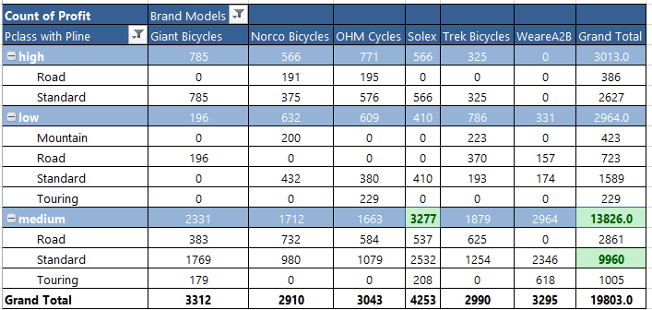
Data Exploration
Top Model Analysis
As per our analysis, the ‘Standard product line bicycles’ have consistently generated the highest profit- $9,960/-, within the ‘medium product class’. That’s why, offering new attractive incentives to influence medium-class customers to purchase bicycles from the Standard product line.
The ‘Solex’ brand has the highest sales in ‘medium class customers’.

Slide 10
Data Exploration
Wealth-Segment Distribution Analysis
According to analysis, The 50% contribution of the Mass customer in bike purchase and it is also highest profit generated wealth-segment, as per last three year bike purchase ratio.
The Australian state-wise wealth-segment, the top segment is Mass Customer, and after that High Net Worth segment.

Slide 11
Data Exploration
Wealth-Segment Distribution Analysis
The wealth segment data of the customers, NSW state has the highest bike purchasing ratio. Therefore, offer a new scheme to purchase bikes for customers from various wealth segments and sectors in the NSW state.
Compared to male customers in the wealth segment, female customers in the wealth segment have a higher purchasing potential for bikes. However, male customers purchase bikes at a second higher rate than female customers.

Slide 12
Data Exploration
Gender Distribution Analysis
As per the chart visualization, it has to provide insight into gender distribution in bike purchase data analysis.
Female customers have made the 52.12% highest contribution to purchasing bikes from Sprocket Company in the Australian market. After that, male customers purchased 47.88% of bikes in the Australian market.
Therefore, focus on improving product quality and marketing to attract a larger female customer base.

Slide 13
Data Exploration
Age Distribution Analysis
As per the customer data analysis, the output visualized on the chart, the most important rapidly growth on this 41-50 to 51-60 age group customers. The high bike purchasing rate in this age group customers.
Therefore, make the policies for bike sales and marketing, so target this age group. And promote the more quality and cost-effective products.

Slide 14
Data Exploration
Job Industries Category Analysis
By analyzing the job industry wise bike related purchase, get insights into it.
The top performing job industries category are- Financial Services, Manufacturing, and the Health.
That’s why, focus on selling bikes to these industries for more profits.

Slide 15
Model Development
Bike 3 Years Purchase Analysis
By analyzing the bike sales data, getting valuable pattern and trends of customers. As per chart data visualization, our new customers mostly females with highest purchase rate in between all wealth-segment compared to the male customers.
Therefore, build better policies and targeting the female customers.
Focus the Mass Customer segment, because our mostly customers of the Mass customer wealth segment.

Slide 16
Interpretation
Job Industries Category Analysis
Analyzing the job industries data through it’s data visualization provide the valuable insights.
These insights has been the top performing industries are Manufacturing, Financial services, Health sector.

Slide 17
Data Insight Conclusion
Top Targeting Customers
Customers Demographic Insights-
The mass customers are 50%, that’s why focus on it, this segment holds 50% of the market.
The top performing industries are Manufacturing, Financial services, and Health, focus on these industries customers.
As per the data, the female customer are give more profits in each sectors compared to male customers.
New Customers Insights-
Target the 41-50 age group female customer and male whose age in between 31-40.
Focus on the Mass Customer segment followed by High Net Worth.
Focus on QLD and VIC state more because they don’t own cars so high chance they will purchase bikes.
Transactions Insights-
The Standard Line Bicycles give highest profit within the medium class.
The Solex brand has the highest sales in the medium product class.

Slide 18
Problem 3 Solution

Slide 19
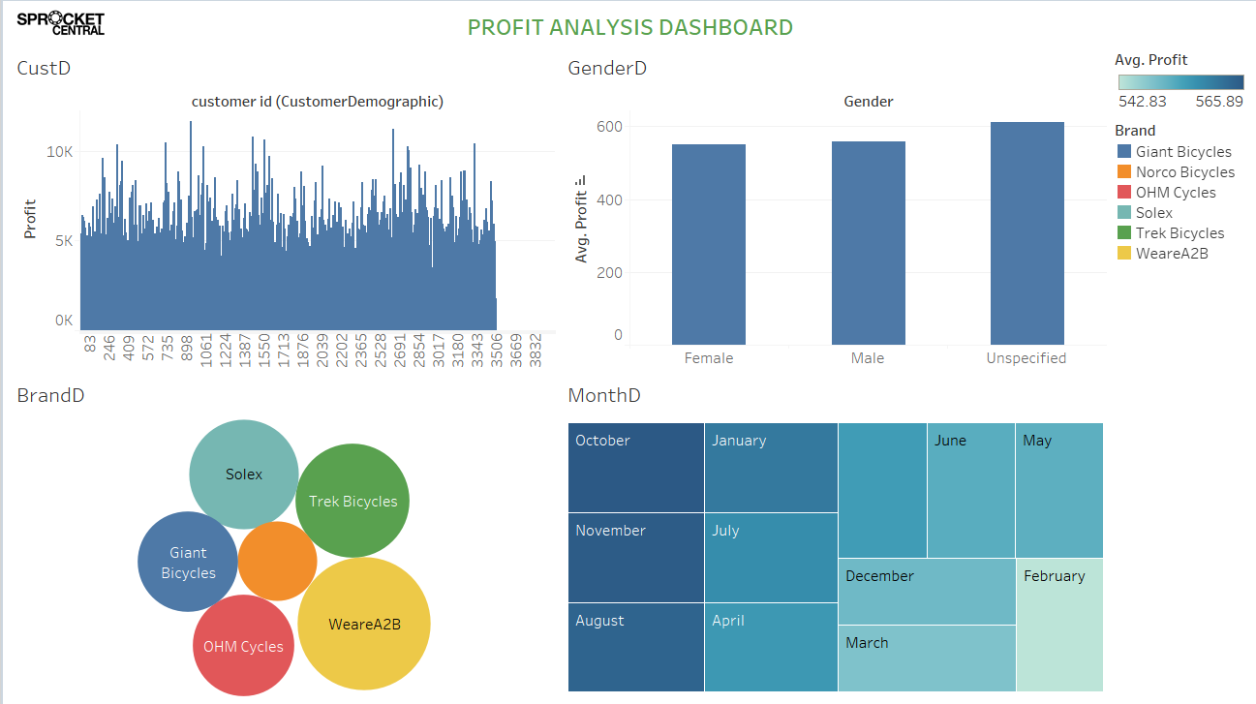
Profit Insight
According to the Brand Distribution profit analysis, the WeareA2B brand has give us highest profit in bicycles business.
In Month Distribution analysis has getting insights, and discover month-wise profit pattern of the identify the top three highest profit achieving months are- August, October, and November also.
As per gender distribution profit analysis, unspecified and Male profit ratio more than females customers.

Slide 20
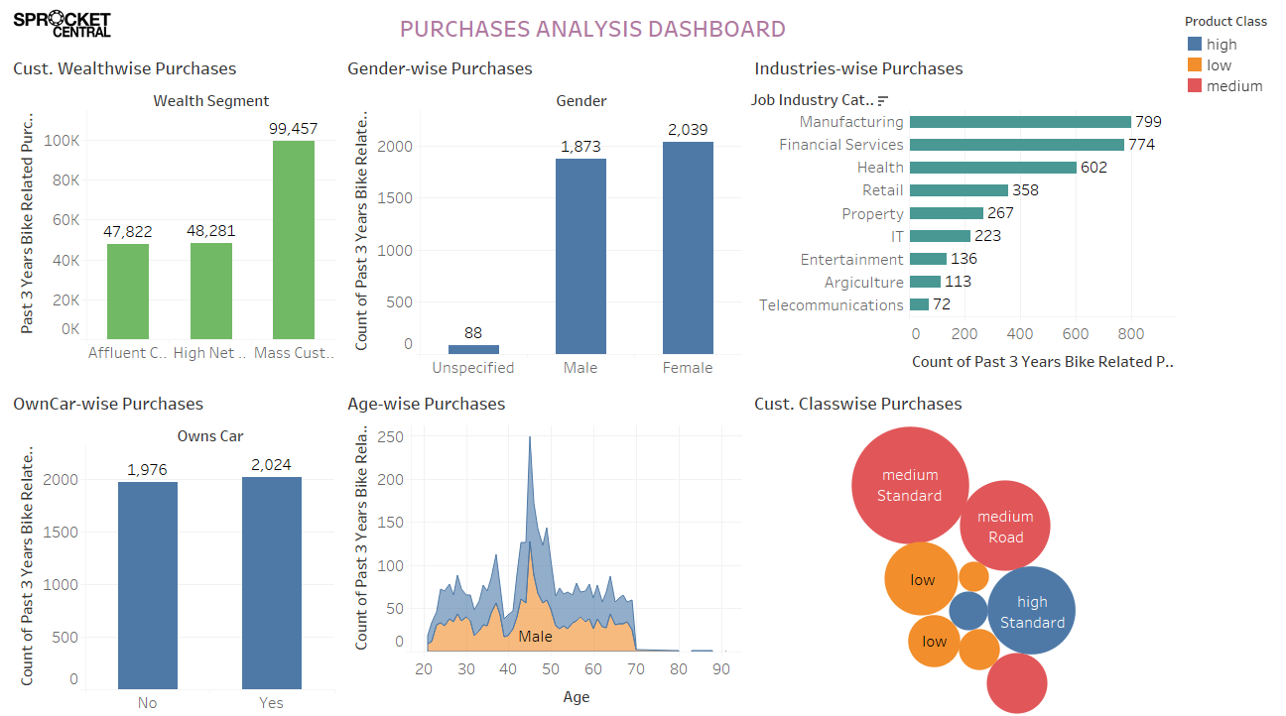
Purchase Trend Of Customer
Customer Trend / Patterns:
Discover the industries with the highest purchase ratio, such as Manufacturing, Financial Services, and Health.
The highest purchasing rate of the Mass Customer Segment.
According to gender analysis, the female purchase rate more than male customers.
Owns car customers has higher purchase rate more than not own car customers.
Female customer has most top purchase rate in 40-50 age group.
Higher Standard product purchasing rate by medium class customers.

Slide 21
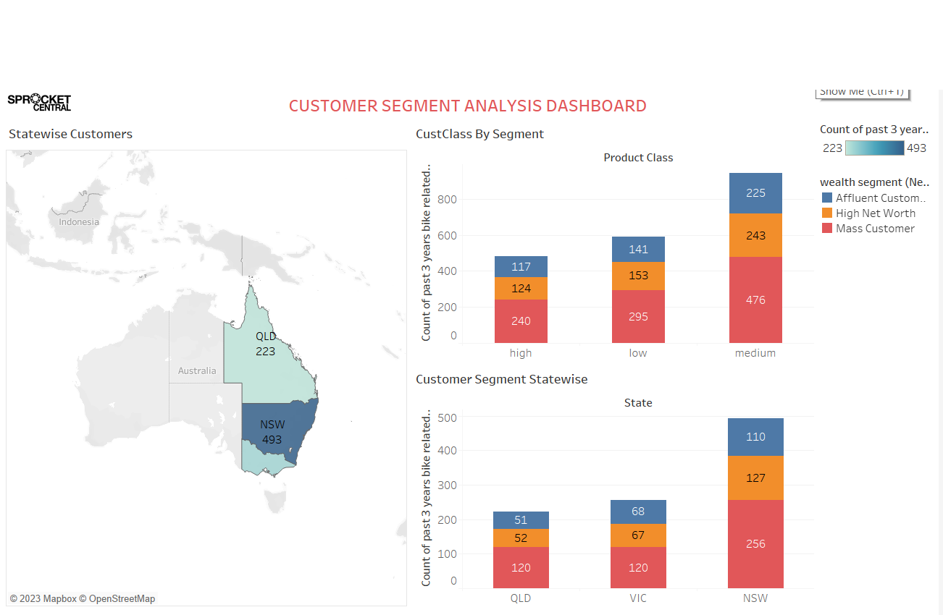
Customer Segment Details
Most of the Customer from Mass Customer Segment, because theirs purchases 476 ratio higher more than other segment customers.
According to map data, our highest customer traffic in the NSW state compared to another states of Australia.
As per state-wise customer segment analysis, we identify our most of the ‘Mass customer segment’ customer come from NSW state, because of their purchasing contribution ratio.

Slide 22
Dashboard Conclusion
Profit Insight-
One of the highest profit has been given by the WeareA2B brand.
In August, October, and November too, we got highest purchases and profit ratio as per data visualization.
As per gender distribution analysis, unspecified and Male customer profit ratio more than females customers.
Purchase trends of customer-
Identify industries with the highest purchase ratio, such as manufacturing, financial services, and health.
In the Mass Customer Segment, we observe the highest purchasing rate.
Gender analysis reveals that female customers have a higher purchase rate than male customers.
Customers who own cars have a higher purchase rate than those who do not own cars.
Among female customers, the 40-50 age group has the highest purchase rate.
In the medium class, most customers purchase more standard-line products than other customers.
Customer Segment Details-
Most customers are from the Mass Customer Segment because their number 476 purchase higher than other segment customer.
As per to the map data, our highest customer traffic is in the NSW state compared to other states in Australia.
Our analysis reveals that the majority of our 'mass customer segment' customers are from the NSW state in Australia because they make significant purchases.

Slide 23
Thank You!
Mr. Nilesh Ambhore
Linkedin Peerlist.io

